Slide 1
Container Fundamentals
Module 7

Slide 2
Module Objectives
After this module, participants will be able to:
Gain a general overview of containers
Learn About Docker
Lean How to Operate Applications with Docker
Perform Orchestration with Docker Swarm
Gain Familiarity with API Tools
Notes:
Instructor Notes:
Please Refer to the Participant Notes. Participant Notes:
These are the objectives for the course

Slide 3
Container Introduction

Slide 4
Deployment Intro

Slide 5
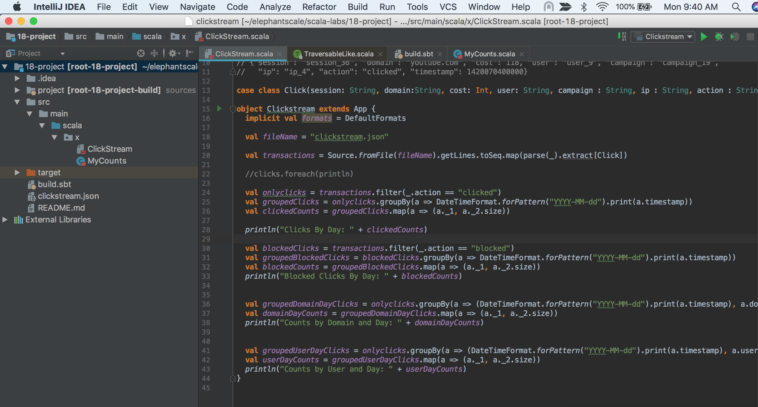
The Problem
You develop an app on your workstation.
You test it. Seems to run fine. Time to deploy.
Notes:
Instructor Notes:
Please Refer to the Participant Note. Participant Notes: We are introducing the problem of deployment. The problem here is that as an application is far more than just code. The code is one small part of an application. We are introducing the "It worked on my computer" problem. VMs are one way to solve that problem, and Containers are another.

Slide 6

Deploying to the Server
We’re ready to deploy to the server.
Provision a new server
Install OS
Install JDK
Install dependency libraries
Etc.
Oops… doesn’t work. Why not?
Missing file?
Wrong version? Path not right
“But it worked on MY computer!”
Notes:
Instructor Notes:
Please Refer to the Participant Notes. Participant Notes: Setting up the environment right usually results in problems. Developers have implicit dependencies on libraries, versions, etc. that are hidden. It's often very difficult to figure out what these dependencies are. Take, for example, a python application. The developer has already installed dozens of packages for other apps. So, this app "just works" because the developer has certain assumptions. On a server, those assumptions won't apply, and the app fails to run. Developers are famous for insisting that "It worked on my computer!"

Slide 7
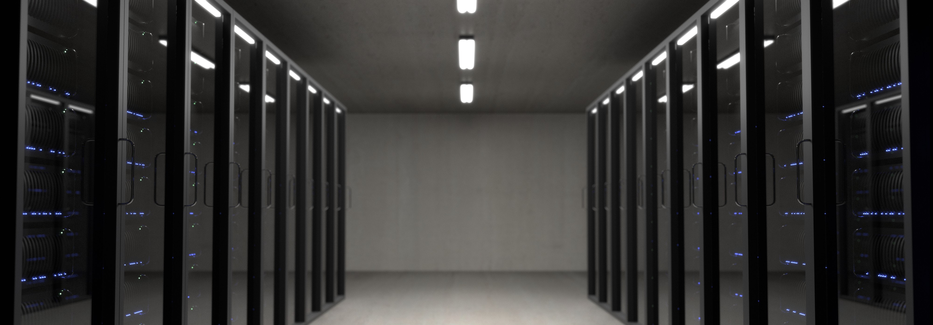
Much Later... Finally Working
Fixed all the problems, now it’s finally working!
Oops… Don’t Touch Anything!
Might break!
Change environment?
Install another app?
Fix breakage.
Make things work together.
Set profiles.
”Write once, run anywhere?”
Not exactly!
Notes:
Instructor Notes: Please Refer to the Participant Notes.
Participant Notes: Once we fix our problems, we’re by no means done. Changes that happen can affect our application. If we install something else on the same server, it can break our application. The problem is that there is no isolation. One app on the server will affect others on the server. We often have to walk on tiptoes on our server to make sure that we don’t break something else. Hosting two apps on the same server is a non-starter. The old Java maxim “Write Once, Run Anywhere” doesn’t really work. Because, the Java app itself may run anywhere, but there’s so much else that comes into play that will either allow or prevent the app from working.

Slide 8

Redeploying to a Different Server
Great news! Our app is very popular. Need to scale up to a bigger, better server!
No problem, right? Wrong!
Create New Server:
Complete steps:
Install OS, install dependencies.
2. Fight fires.
3. Fix problems.
Notes:
Instructor Notes:
Please Refer to the Participant Notes. Participant Notes: Here we come to the point where our deployment environment can take on a life of its own, so we can get to a "but it worked on my server!" kind of mentality. This makes it very difficult for us to move servers, especially if that server is different in any way from the original one. Some will rightly point out that this is the basic problem that VMs are trying to solve, and, indeed, VMs are a reasonable solution to this.

Slide 9

Redeploy to Cloud
Redeploy to Cloud
Cloud configuration is different
Redeploy
Re-Test
Fix fires
Notes:
Instructor Notes:
Please Refer to the Participant Notes. Participant Notes: Cloud is yet another configuration compared to on-prem. How will that affect things? Likely, it will involve even more firefighting.

Slide 10

But it Worked on MY Computer
How many times have you heard this line:
It worked on my computer!
When we develop, we’re not really developing an application:
We are developing an environment
The code itself may be portable
But the environment is not!
Notes:
Instructor Notes: Please Refer to the Participant Notes. Participant Notes: This is the main point – we are developing an environment. The app is just one small piece of the stack. We have the OS, other applications, the filesystem, the IO devices – all of these are part of what makes the app do what it does. Real portability means that we have to somehow manage to transport all of these things together with the app. Some will point, again, to the VM as a solution to this problem, but we will see how containers differ from this.

Slide 11
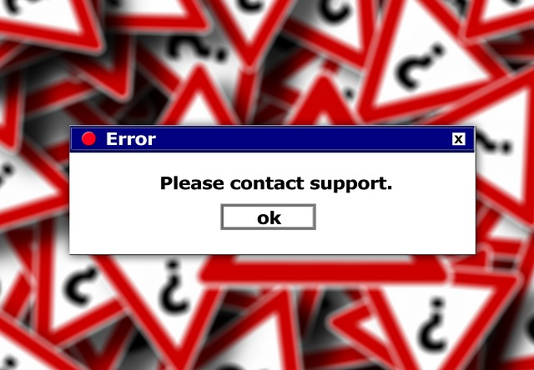
Remember Windows DLL Problems?
You install one application, which has some DLLs such as MSEXAMPLE.DLL.
Some of those DLLs are shared between applications.
So, we register them in the COM (Component Object Model) as MSEXAMPLE -> c:\Windows\MSEXAMPLE.DLL.
Now, install a new application, which also needs MSEXAMPLE.DLL.
It now re-registers the same DLL:
MSEXAMPLE -> C:\Program Files\MyAPP\MSEXAMPLE.DLL.
Notes:
Instructor Notes:
Please Refer to the Participant Notes. Participant Notes: DLL Problems is one of the reasons why Windows deservedly gained such a reputation for instability. By putting code in shared libraries, but giving no way to control or version those libraries, early Windows systems could find their way into insidious dependency scenarios where neither app would work. The solution, more often than not, was to simply reinstall everything, including the OS, from scratch. While modern windows is more mature, the problem still exists on Windows systems, just like it does on other OS systems. Different apps, once installed, can have side-effects that affect the running of other apps. To be fair, other OS platforms suffer from the same issue. In fact, it’s a pretty universal problem.

Slide 12
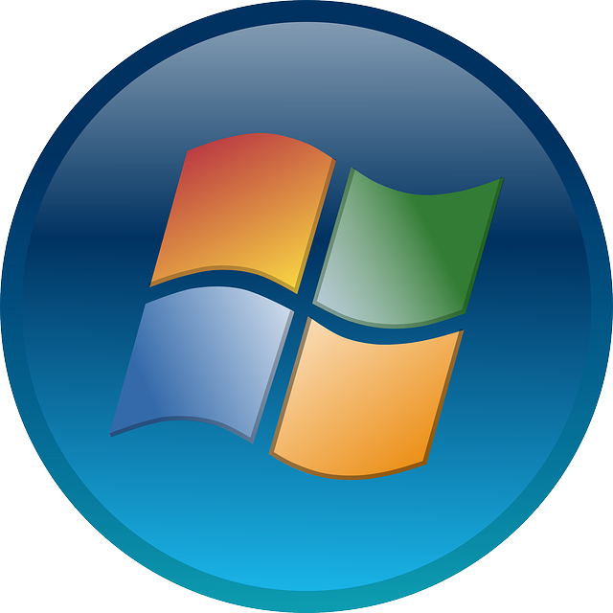
Windows DLL Problem
So what’s the problem?
What if there are several different versions of the same DLL?
Last one Wins! (DLL Stomping)
First App no longer works!
Uninstall the second app?
Nope still doesn’t work.
Start Over from Scratch!
Notes:
Instructor Notes:
Please Refer to the Participant Notes. Participant Notes:

Slide 13

Dependency Problem
DLL Problem is an example of Dependency Problem
Dependency Problem :
Multiple dependencies.
Multiple configurations.
Applications not isolated.
Notes:
Instructor Notes:
Please Refer to the Participant Notes. Participant Notes: ”Dependency Problem” is the extension of the DLL problem to other platforms and situations. Indeed, the fact that we have decades of “DLL Problems” or “Dependency Problems” war stories means that we’ve not yet come up with the perfect solution to this problem.

Slide 14

Solutions to Dependency Problem
Static Linking:
Include all dependencies in .EXE (Windows)
Make a Fat JAR (Java)
Some kind of application registry:
.NET GAC (Global Application Cache)
Package Management Systems:
Apt (Ubuntu/Debian), RPM (RedHat)
Problems:
Only good for one application.
Filesystem itself not included.
No isolation.
Notes:
Instructor Notes:
Please Refer to the Participant Notes. Participant Notes: Fortunately, Dependency Problem isn’t usually a fatal problem. Static Linking is one solution that we see in both Windows and Java – just include all dependencies together in the same .EXE (Windows) or .JAR (java). Since most application code isn’t really all that big on a modern system, sometimes trying to share code between multiple applications is just a big waste of time. There are some ingenious solutions to the problem. Microsoft, for example, invented the GAC (Global Application Cache) for .NET assemblies, to avoid dependency hell problems. Unfortunately, it only applies to managed .NET code and the .DLL hell problems tend to occur more with the unmanaged Windows DLLs. Even when these solutions work, they only fix the problem for the one application. And, any dependencies on the filesystem aren’t helped at all. Nor is there any isolation between processes. This mean that these solutions aren’t the silver bullet that we would like to see.

Slide 15
The Matrix Of Big Problems
 | Dev VM | QA Server | Prod Instance | Prod Cluster | AWS | Laptop
HTML/CSS | ??? | ??? | ??? | ??? | ??? | ???
Back-End Code | ??? | ??? | ??? | ??? | ??? | ???
App DB | ??? | ??? | ??? | ??? | ??? | ???
Analytics DB | ??? | ??? | ??? | ??? | ??? | ???
Worker Processes | ??? | ??? | ??? | ??? | ??? | ???
Queue | ??? | ??? | ??? | ??? | ??? | ???
Notes:
Instructor Notes:
Please Refer to the Participant Notes. Participant Notes: This “The Matrix Of Big Problems” is adapted from the website http://www.docker.com / The idea here is that we have a number of different components to our app: front-end, back-end, various DBs, services, queues, etc. These things all come together to make our app, like pieces of the puzzle. Those pieces will have to be assembled in just the right way on each of our deployment platforms, from local to test, to QA. How do we ensure that our app works the same way on each of them? There are many combinations of factors, which is why we call this the ”Matrix from Problem”. It becomes a big headache to make sure that all the various components of our app, on the rows of the matrix, all work properly on the columns of our matrix, which are the various deployment platforms.

Slide 16

Delivering a Comprehensive Application
What if we could move all of the following:
Application code
Application dependencies
Configuration files
Local database(s)
Environment variables
Filesystem
Service processes
All as a “sealed unit”
Without having to re-deploy
Reconfigure
Notes:
Instructor Notes:
Please Refer to the Participant Notes. Participant Notes: Here we’re talking about the use case of taking all of our application components and delivering them all as a sealed unit, so that none of the components can be deployed without the others. We are trying to communicate the value of having our application delivered as a whole.

Slide 17
Virtual Machines (VMs)

Slide 18

There is a Better Way: Virtualization
Virtualization has taken the Datacenter by storm.
With Virtualization, we can easily move a whole virtual environment from server to server.
We can pause, stop, restart, and terminate instances on the fly.
Frees datacenter ops to focus on server infrastructure and not application.
Agility: much easier to get new VM instance than a new hardware server provisioned.
Notes:
Instructor Notes:
Please Refer to the Participant Notes. Participant Notes: Virtualization has historically been the answer to these problems. We’ll see in a minute the advantages and disadvantages of containerization versus virtualization. Virtualization allows us to easily start, stop, and move VMs between machines, simplifying many of our deployment headaches.

Slide 19
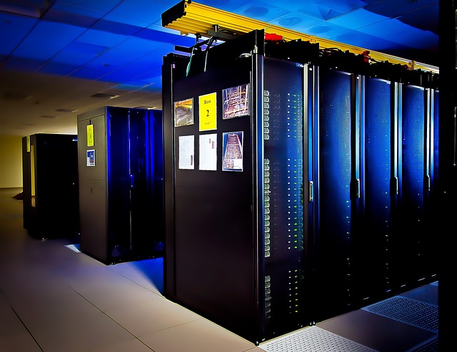
The History of Virtualization
Mainframes have used VMs for a long time. (1960s/1970-Present)
Thousands of VMs on a single mainframe.
Achieves scalability and isolation on mainframe systems.
PC Era (1990s)
VMs a “mainframe” technology and out of vogue.
Just run the app on the ”bare metal”.
Notes:
Instructor Notes:
Please Refer to the Participant Notes. Participant Notes: VMs have been around since the mainframe era, and allow multi-tenancy much more effective. As we can see, VMs became much more popular in the mid-2000s as VMWare and other providers came out and CPU vendors started to make hardware virtualization. That said, there are disadvantages to virtualization. “Bare metal” undeniably runs faster.

Slide 20

History of Virtualization (Continued)
Application Servers (Late 1990s – 2000s)
Deploy app to application Server.
Sysadmins managed deployment of application.
Still ”bare metal”.
Intel/AMD Support Hardware Virtualization (2006-)
Enables isolation of VM processes.
VM security.
Notes:
Instructor Notes:
Please Refer to the Participant Notes. Participant Notes: In the modern era, virtualization is ubiquitous and assumed -- if I have a server instance I'm sure it's really a VM and not a "bare metal" instance. The ability to copy my instance and redeploy it is something that we normally take for granted in this day and age.

Slide 21
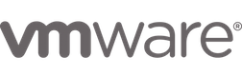
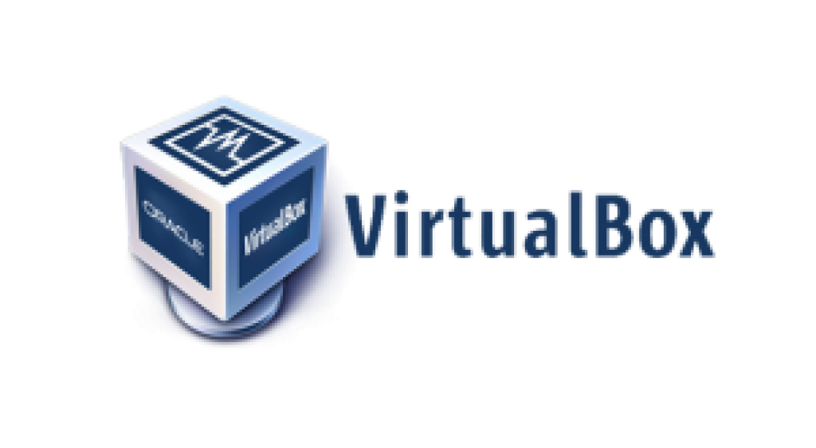
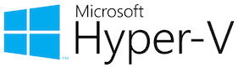


Virtualization Providers
Notes:
Instructor Notes:
Please Refer to the Participant Notes. Participant Notes: This is just a list of the common Virtualization providers. VMWare is the industry leader in the space, especially for deployment. Windows Hyper-V is used in Microsoft-centric deployment environments. Xen/KVM and others are open-source technologies used in some environments. All basically work the same way – they are the application team that creates a SM image, and then that image can be deployed at will to send the app (as long as licensing requirements are met). Changes to the app can then go to the VM image, which can then be deployed properly.

Slide 22

The Cost of Virtualization
Performance:
Virtual hardware doesn’t run as well as bare-metal.
It can be MUCH slower in some cases.
We end up with multiple redundant operating systems for each VM:
Overall, though, it’s worth the cost.
Our application VMs are sealed from each other.
Sealed from host OS.
We can copy VMs between machines without much problem.
Virtual Instances make better use of hardware.
Large bare-metal servers can balance resources among several running VMs.
Notes:
Instructor Notes:
Please Refer to the Participant Notes. Participant Notes: There is a cost to virtualization. It's a cost that's worth it, but there is no denying that there's a cost. Today, we normally think of total cost of ownership. If we need more power, we can just make ourselves a bit of a bigger instance than what we would ordinarily expect on bare-metal.

Slide 23
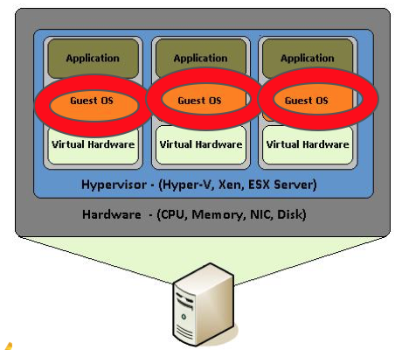
The Problem with Virtualization
Notice how many Guest OS we have here.
Do we we really need a separate guest OS for each VM?
Notes:
Instructor Notes:
Please Refer to the Participant Notes. Participant Notes: This image indicates the problem with virtualization. We are virtualizing an entire machine, including the Operating System. Of course, this has tremendous advantages in some cases. We are isolating our VMs from each other completely. It also allows us to run different OS platforms simultaneously, which is a primary motivator for desktop virtualization, especially on Mac and Linux platforms (to run Windows apps, for instance). But most of the time, this is just a waste. The Host itself has an OS running in order to run, then, each of the guests have an OS as well. Do we really need to run copies of the OS? The solution is often to run the most stripped down, lightweight OS possible in each of the guests. But why do we need the guest OS in the first place – we already have an OS – the host OS! The performance is one thing, but what about the time it takes to start?

Slide 24
Introducing Containers

Slide 25
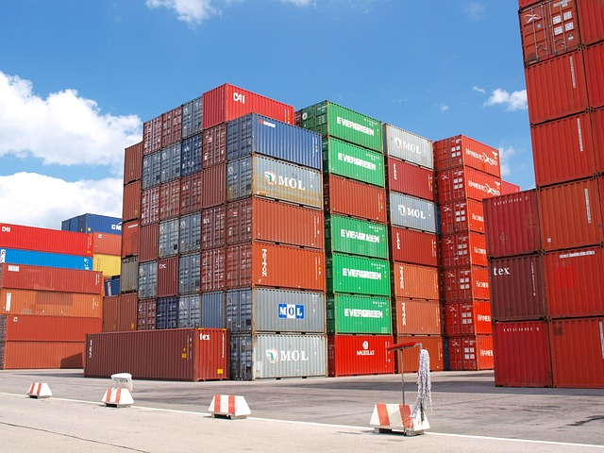
What are Containers
Containers are:
OS Level Virtualization
Application Code + Filesystem Image code = Packaged Together
How is it different from Virtualization?
Only the ”Userland” is virtualized.
The kernel is shared with the host.
Both Host and Guest have to be the same OS (with some exceptions).
Usually Linux.
Microsoft has worked with Docker to have Windows containers as well.
Notes:
Instructor Notes:
Please Refer to the Participant Notes.
Participant Notes: Here we introduce containers. Containers are a bit like a VM with no OS. Strictly speaking, the containers DO have some of the OS, but NOT the OS kernel. In order for this to work, the kernel has to be the same. In the past, this has meant using Linux, but in modern versions of Docker Windows containers are supported as well.

Slide 26
Containers Versus Virtual Machines
 | Container | Virtual Machine
OS | No OS Kernel, use Host's OS Kernel | Each Virtual Instance has its own OS
Filesystem | Dedicated Filesystem | Dedicated Filesystem
Isolation | Uses Virtualization API of host kernel for some isolation | Uses guest isolation for more robust isolation
Guest OS Support | Same as Host (usually Linux) | Can run any OS that supports host CPU.
Start/Stop Time | milliseconds | seconds to minutes
Notes:
Instructor Notes:
Please Refer to the Participant Notes. Participant Notes: Here we compare the similarities and differences between the VM and the Container. The main advantage of the container here is performance. There’s minimal startup time for a container, and there’s no performance penalty to running on a container. Note here that the filesystem, libraries, and other dependencies are handled very similarly for containers versus VMs – in both cases, they are on the guest image rather than on the host.

Slide 27
Containers Versus Package Managers
 | Container | Package Manager
Filesystem | All dependencies installed to container filesystem. | All dependencies installed to local filesystem.
Isolation | Userland isolation, kernel shared. | No isolation. Processes run together.
Dependencies | Dependencies put in container. | Can have circular dependency issues.
Notes:
Instructor Notes: Please Refer to the Participant Notes. Participant Notes: Containers in some ways resemble package management systems like apt on Ubuntu/Debian and rpm/yum on RedHat. In both cases, they are designed to help improve deployment, and are in a sense different solutions to the same problem. Package Managers, however, can and do have dependency issues, and are generally not suitable for deploying user developed applications across various platforms.

Slide 28
Solving the Matrix from Problem
 | Dev VM | QA Server | Prod Instance | Prod Cluster | AWS | Laptop
HTML/CSS | Container | Container | Container | Container | Container | Container
Back-End Code | Container | Container | Container | Container | Container | Container
App DB | Container | Container | Container | Container | Container | Container
Analytics DB | Container | Container | Container | Container | Container | Container
Worker Processes | Container | Container | Container | Container | Container | Container
Queue | Container | Container | Container | Container | Container | Container
Notes:
Instructor Notes: Please Refer to the Participant Notes.
Participant Notes: This slide follows up with the Matrix from Problem, showing that the same container is able to run on all of our production, test, QA, staging, and development platforms.

Slide 29
When NOT to use Containers
Multiple OS | VMs allow a single computer to run multiple OS, such as Linux, Windows, etc. For example, we could run a Windows Guest on a Linux Host. This is not possible with containers.
Kernel-Level Isolation | If you need various custom kernels or run kernel-level code, you need virtualization. Containers share the host kernel.
Root or Privileged instructions | Containers can run root, but it only applies to root within the container and not outside.
Tightly-Coupled Data | When the application is tightly coupled to its own data, containers aren’t a good solution. This is not generally a good design principle, however.
Security Concerns | Sharing the kernel means that kernel exploits in the container will affect the host as well. Containers should not be used for untrusted code execution.
Notes:
Instructor Notes:
Please Refer to the Participant Notes. Participant Notes: There are a number of use cases NOT to use containers. Here is some explanation: Multiple OS: One of the main use cases for desktop virtualization is to run various Operating Systems. This can be because, say, For example, Mac users want to run their favorite Windows Application, or Windows users want to run something inside of Ubuntu Linux. Containers don’t help in this regard, because they are mainly about sharing the host kernel. That said, we will see how docker will use a combination of virtualization and containerization on development platforms to allow running containers across different OS platforms. Kernel Level Isolation. Nothing can beat a VM’s isolation at the kernel level. While it may be more efficient to share a kernel, it means we have to share the same kernel. If we want optional kernel modules in one app versus the other, only a VM can do that. If we want to run privileged code, we can’t do that either in a VM or in a container. Of course, in either case we can certainly run as root, but the results will only be seen inside the container or VM, and not outside. If we have an application that is tightly coupled to its data, then containers will make life complicated. What does it mean to be tightly coupled? Let’s say, for example, that the application is designed to store data as local files in its run directory. This is generally a really bad idea, but one that is extremely common. Containers can complicated because the app is generally designed to run from an immutable container image. Changes to the state of the application are reserved fro changing the data, which we want in special attachable volumes. Security: Running untrusted code is not a good use case for containers. While containers do make it more secure to do so than without the container, code run in the container which involves a kernel exploit will then affect the host kernel, and with it the running kernel for all other containers. On the other hand, an exploit running in a VM can at worst give the attacker control of the kernel within the VM itself, and in most cases will leave the host untouched.

Slide 30
Container History

Slide 31
History of Containers
1982: Unix ”chroot” command: Allows filesystem-level isolation
2000: BSD “jail” command
2005: Linux namespaces: Process isolation
2007: Linux Cgroups: Resource Isolation
Allows process and children access to an isolated filesystem.
Users, processes, network, and other resources shared.
Allows filesystem, user, processes, and network isolation.
Inspired Solaris Zones, which combines jail with dedicated ZFS filesystem.
Segregate processes into groups.
Processes can’t talk between groups.
Control mem, CPU, resource allocation for running processes and groups.
Notes:
Instructor Notes: Please Refer to the Participant Notes.
Participant Notes: There is a long history of container building blocks in Unix systems. It's important for learners to remember that containers didn't come out of thin air, and Docker was by no means the first company to create containers. Docker's ingenuity was mainly to create an attractive, easy-to-use ecosystem for containers. It's a lot like the relationship between git and GitHub. Git was around long before GitHub, but GitHub created a set of tools and integration that made Git a lot easier to use. Users should be familiar with "chroot" if they have used Linux. chroot is for filesystem isolation. chroot has been around since forever, and it gives the ability for a process to have a customized, usually restricted view of a filesystem. It does not give users the ability to combine together different filesystems or parts of a filesystem. To do that, you need OverlayFS or a similar tool. The Jail command only exists in BSD, and interestingly a variation of a BSD jail is used in Apple's iOS. Each app runs in a "jail", which is why installing unauthorized Apps is called "jailbreaking." Typically, breaking out of a jail requires some sort of exploit, it's a bit like gaining root access to a computer. Jails are good for running code which is not completely trusted, but it's not as secure as running inside a VM. Linux namespaces are design for process isolation. This means that we can develop groups of processes, each with their own PIDs, names, etc., and the processes in one group cannot see or communicate with those in another group. It is called namespaces because we can have duplicate PIDs in different groups, and that's OK, similar to namespaces in programming languages like C++ and Java. Cgroups allow us to do resource isolation. It's a bit like "nice" on steroids, allowing us to be able to much more strictly partition resources such as memory, CPU, I/O devices, much in the same way that we would partition for a VM. However, Cgroups are NOT VMs, just merely a way to control existing process's resources.

Slide 32
Linux Containers
2008: Linux Containers (LXC): Combines together:
2013: LXC + Virtualization extensions
2014: LXC + OverlayFS or UnionFS
chroot: (filesystem isolation) +
Namespaces (process isolation) +
Cgroups (resource isolation)
Allows hardware support for virtualized namespaces.
Allows for multiple filesystems to be combined to one virtualized filesystem.
Allows more practical overlay of containers than chroot.
Notes:
Instructor Notes:
Please Refer to the Participant Notes. Participant Notes: Linux Containers, or LXC is really the combination of chroot, namespaces, and Cgroups. These three things together make up Linux Containers, which are the Linux replacement for the BSD jail, which does not work on Linux. As LXC is built into the Linux kernel, there is no need for any customization to make it work in modern Linux. Since Docker containers were originally built on top of LXC, LXC is a good basis for understanding how Docker works. Since version 1.1 of Docker, all LXC dependencies have been removed, though kernel namespaces and Cgroups are still requirements for Docker. LXC originally did not use hardware virtualization support at all, and is still not required, strictly speaking for simply containerizing. However, the VT-x extensions can be useful for process isolation and so are used. Docker as we know it today could not exist without OverlayFS or UnionFS. That's because the way we layer containers filesystems on top of one another is not possible with chroot alone. OverlayFS or UnionFS allows us to put many filesystems on top for each other to make a virtual filesystem for the container.

Slide 33

Docker
2013: Docker released
Docker combines together the following:
Namespaces
Cgroups
LXC
OverlayFS
Docker created a new container format
Docker Container format is now the standard container format.
Developer Tools
Docker has developed developer toolchain to use its container format.
Notes:
Instructor Notes:
Please Refer to the Participant Notes. Participant Notes: Docker has become the de-facto standard component for containers. Interestingly, prior to Docker's release, container management systems like Mesos and Kubernetes used other container formats. However, given Docker's popularity most of the toolchains has converted to Docker. It's important to note that Docker relies on standard Linux kernel features in order to perform what it does, the same features that are done by LXC. Docker's main contribution has been its container format, which is now the standard. Docker containers are also storable via Docker Hub or other Docker repositories. Docker's developer toolchain is its other main contribution. Docker's tools allow users to very easily create new containers using its Dockerfile format, which is intentionally similar to Makefiles.

Slide 34
Docker Overview

Slide 35
Introducing Docker

Slide 36
What is Docker?
Docker is the current industry standard container format.
Docker (the company) also makes developer tools:
Docker for Windows
Docker for Mac
Docker for Linux
Docker also has server-side container frameworks for Linux and Windows
Windows versions run on top of Hyper-V
Notes:
Instructor Notes:
Please Refer to the Participant Notes. Participant Notes:
Docker's name is almost synonymous with containers. While arguably Docker's contribution is not the largest or the most significant to the container ecosystem, it is the one that is closest to the developer -- as the developer relies on Docker tools to create container application images.

Slide 37
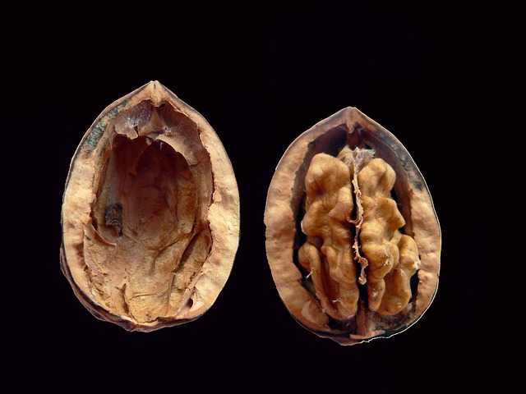
Docker uses the Host Kernel
Docker will use the host kernel on Linux.
What about Windows and Mac (Developer) Versions of Docker?
Windows and Mac versions run a virtualized Linux kernel in a VM
Only the kernel runs in the VM. The container runs separately.
In Windows, the VM is in Hyper-V (and thus requires Hyper-V to be installed)
On Mac, the VM runs in Apple’s Hypervisor Framework
Windows Server Native Windows Kernels
Windows Server Applications can run in Windows Native Containers on Windows Server
No VMs involved. (although you may want a VM for security reasons)
Notes:
Instructor Notes:
Please Refer to the Participant Notes. Participant Notes:
It's important to understand how containers work. They generally use the host kernel. We say generally because in fact on non-Linux platforms the kernel is usually virtualized.
The situation is a little complicated when it comes to Windows, because there are multiple incompatible Windows kernels for various flavors of Windows. Because of that, most Windows "Native" containers run in virtualized mode except in production.

Slide 38
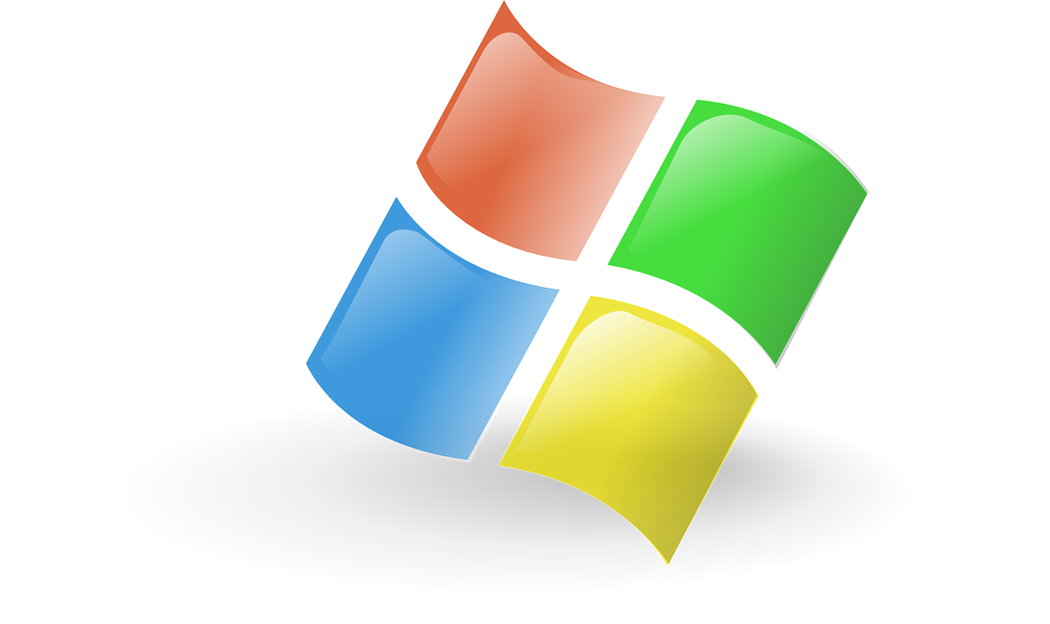
Docker for Windows (Developer)
Docker for Windows has the following requirements:
Windows 10 Professional 64 Bit (or Higher) (not Home, Not Home Pro)
Virtualization Extensions Available in CPU and turned on in BIOS.
Hyper-V (optional component) installed
Reasonable CPU / Memory requirements
Docker Toolbox
Windows Users unable to run Docker for Windows can run in Docker Toolbox
Toolbox requires Oracle VirtualBox for Virtualization.
Notes:
Instructor Notes: Please Refer to the Participant Notes. Participant Notes: Docker for Windows has fairly steep requirements. Why does Docker require Hyper-V? Because all containers on Windows require virtualization. Even windows containers require virtualization because those containers require Windows Server kernels which are different from Windows 10 (client) kernels. Hyper-V does not run on Windows Home versions (most consumer-grade windows machines). So, Docker for Windows will not run on those versions either. One needs a Windows Professional. Hyper-V will require that Virtualization extensions be turned on in the BIOS. Typically, from the factory these are turned off on client machines for security reasons, as some exploits have targeted these instruction sets. Docker Toolbox can be used together with Oracle VirtualBox to run Docker containers on older versions of windows such as 8.1 or 7 or on Home versions of Windows 10. However, it’s a pretty painful developer experience, so it’s not recommended.

Slide 39
Docker and Windows Server
Docker for Windows Server is designed for App deployment rather than Development
Developers should use Docker for Windows instead.
Supports running Linux containers containers (via Hyper-V)
And Native Windows Containers (using Hyper-V or native Windows Containers)
Native Windows Containers
Native Windows Containers must use the same Windows Server kernel as the host
Both host and guest must be Windows Server to run native (not Windows 10)
Native Windows Containers must use Windows Server kernel
Able to run native containers without virtualization
Minimal Performance Penalty
Notes:
Instructor Notes:
Please Refer to the Participant Notes. Participant Notes:
This slides shows the relative use cases of various use cases on Windows. Docker realizes that Windows is its most common platform for development, even for applications that will not be deployed on Windows. Because of this, the Windows platform has the richest number of options. Windows users need to choose between developing "native" Windows server containers or Linu containers. The advantage of the native containers is that there is minimal delay in starting a native container, similar to what one would expect on Linux platforms.
Native Windows Containers are not all that common at this time, but Microsoft is pushing them because they realize that the Windows platform needs to be have this capability to continue to be relevant as a server-side platform.

Slide 40
Docker on Windows Use Cases
 | Windows 10 (Linux Kernel) | Windows 10 (Windows Server Kernel) | Windows Server (Virtualized Kernel) | Windows Server (Native Kernel)
Use Case | Developer | Developer | Deployment | Deployment
Container OS | Linux | Windows Server | Linux or Windows Server | Windows Server
Isolation from Host | Yes (via Hyper-V) | Yes (via Hyper-V) | Yes (via Hyper-V) | Not Virtualized
Startup Delay | 500ms - 1s | 500ms - 1s | 500ms - 1s | No Delay
Notes:
Instructor Notes:
Please Refer to the Participant Notes. Participant Notes:
This slides shows the relative use cases of various use cases on Windows. Docker realizes that Windows is its most common platform for development, even for applications that will not be deployed on Windows. Because of this, the Windows platform has the richest number of options. Windows users need to choose between developing "native" Windows server containers or Linu containers. The advantage of the native containers is that there is minimal delay in starting a native container, similar to what one would expect on Linux platforms.

Slide 41
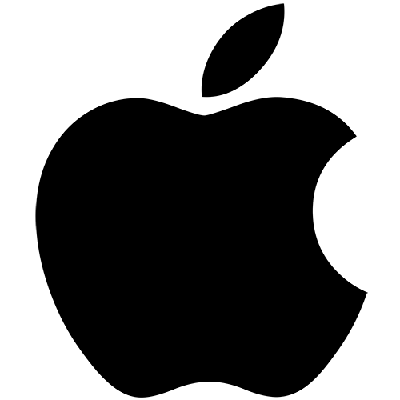
Docker on Mac (Developer)
Docker on Mac is only supported as a development platform.
There are no ”native” mac containers as there are on Linux and Windows
Docker for Mac uses only Linux containers
Windows containers can be run entirely inside a VM
Linux Containers use a VM for the Linux kernel only
Docker for Mac uses Apple’s VM Hypervisor
Notes:
Instructor Notes:
Please Refer to the Participant Notes. Participant Notes:
Apple is an extremely popular platform for development, so it comes as no surprise that Docker has versions for this platform. As Apple has no real presence in the data center, it is strictly for development.
While it's often thought that Apple is built on top of Unix, it has chosen BSD Unix as its base, which is not compatible with the Linux Kernel. So, like Windows, Mac users must run in a VM, though unlike Windows, all modern Mac systems are capable of running virtualization without any special actions.
There is no way to run "native" Windows containers on Mac, except for in a VM. This isn't a common use case.

Slide 42

Lab 1: Installing Docker
Docker-labs/01
Instructions:
Open the document: 300S-07-Container-Fundamentals-Lab2.doc
Refer to the folder: 300S-07-Container-Fundamentals-Lab2-File
Notes:
Instructor Notes:
Participant Notes:

Slide 43
Docker Hub and Container Registries
Notes:
Instructor Notes:
Please Refer to the Participant Notes. Participant Notes:

Slide 44

What is Docker Hub?
Docker Hub is a registry of containers
Think "GitHub" for containers
Thousands of Containers Available
We rarely start from scratch
Use an image from Docker Hub!
Notes:
Instructor Notes:
Please Refer to the Participant Notes. Participant Notes:
If Docker's container image format is its first great contribution, Docker Hub and similar container registries are the second. The fact that users can share and get container images from Docker Hub is a huge catalyst to containers, as it allows code to be shared across multiple teams. More importantly, it means there's no reason to re-invent the wheel. In fact, Docker Hub is designed to minimize re-invention of any kind.
We will see later how Docker's build process allows us to leverage other people's work.

Slide 45

Container Registries
Docker Hub is public.
Your company data is NOT .
You may want to have your own container registry.
But we may still use Docker Hub as well.
Notes:
Instructor Notes:
Please Refer to the Participant Notes. Participant Notes:
Corporate environments invariably have Docker Hub blocked, much like Maven repository coordinate and Github itself. Because of this, companies are able to use private container registries. In fact, this is encouraged in Docker and rarely will someone attempt to put something out on public Docker Hub unless there is a very good reason to do so.
The doesn't mean that one can't use Docker Hub. If you want to start with, say, a basic linux image, using something from Docker Hub as a start makes a lot of sense.

Slide 46
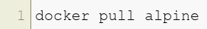

Docker Pull
Typing docker pull will download a container.
In the lab, we will use a container called alpine :
Ultra-lightweight Linux
4MB in Size (tiny).
Notes:
Instructor Notes:
Please Refer to the Participant Notes. Participant Notes:
Anyone who has used Github and Git will find the Docker syntax easy to remember. Instead of using a copy of the source code repository, Docker will store the binary container image (usually a hash) in a local place on the user's hard drive.

Slide 47
Docker Commands

Slide 48
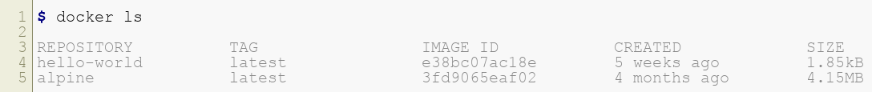

Docker LS (list)
typing docker ls will list your containers
It will only show running containers
Stopped containers say `docker ls -a'
Notes:
Instructor Notes:
Please Refer to the Participant Notes. Participant Notes:
Running "docker ls" will show all the containers that you currently have. Note that you may see containers show up that aren't in fact directly being used. That's because the docker pull will recursively bring down containers and store them.
Note that every time you start a container, you will continue to see that container in docker ls. Do not be alarmed, because only the differences between the original image and the stopped container will be stored.

Slide 49

Docker Run
We can run a docker container with docker run .
Example: running alpine
This will run alpine and start a shell
Alpine doesn't have "bash" -- too big!
Notes:
Instructor Notes:
Please Refer to the Participant Notes. Participant Notes:
Docker containers can be started with "run" -- this is because it's better to look at running a container as more like an app than a VM.
Alpine is extremely popular as mini-sized Linux to start containers. While running with a starter like ubuntu certainly gives a lot more power plus the familiarity with ordinary tools like "bash", alpine is great when all we really need is just enough of an OS to run our application.

Slide 50
Running a Shell
We don't typically ssh to our container.
We simply run a shell in the container
What does this mean?
-i : interactive mode
-t : terminal mode
--rm : remove container after we are done
/bin/ash : bash is big and needs to be installed. ash (almquist shell) is small. We also have old-school sh.
Notes:
Instructor Notes:
Please Refer to the Participant Notes. Participant Notes:
Many users ask how to "ssh" to the container. This isn't typically how we accomplish this, instead, what we do is to attach our terminal to the container.
Some containers we probably want to automatically stop when we are not longer using the container. This depends a lot of the use case. If the container is more of background service, then we probably do not want to do this. However, if it is an interactive application then this is not a bad idea.

Slide 51
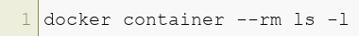

Docker RM
What happens if we need to delete a container?
The docker rm command will do this trick for us.
Notes:
Instructor Notes:
Please Refer to the Participant Notes. Participant Notes:
Running "docker rm" is a good way to clean up and de-clutter our container registry. That said, one should not expect to save lots of space by running docker rm, because even larger container images are stored in the base repository, and deleing our derived images from these will not save an extraordinary amount of space. Remember, Docker overlays changes from one filesystem to the next, so only the changes will be removed.

Slide 52
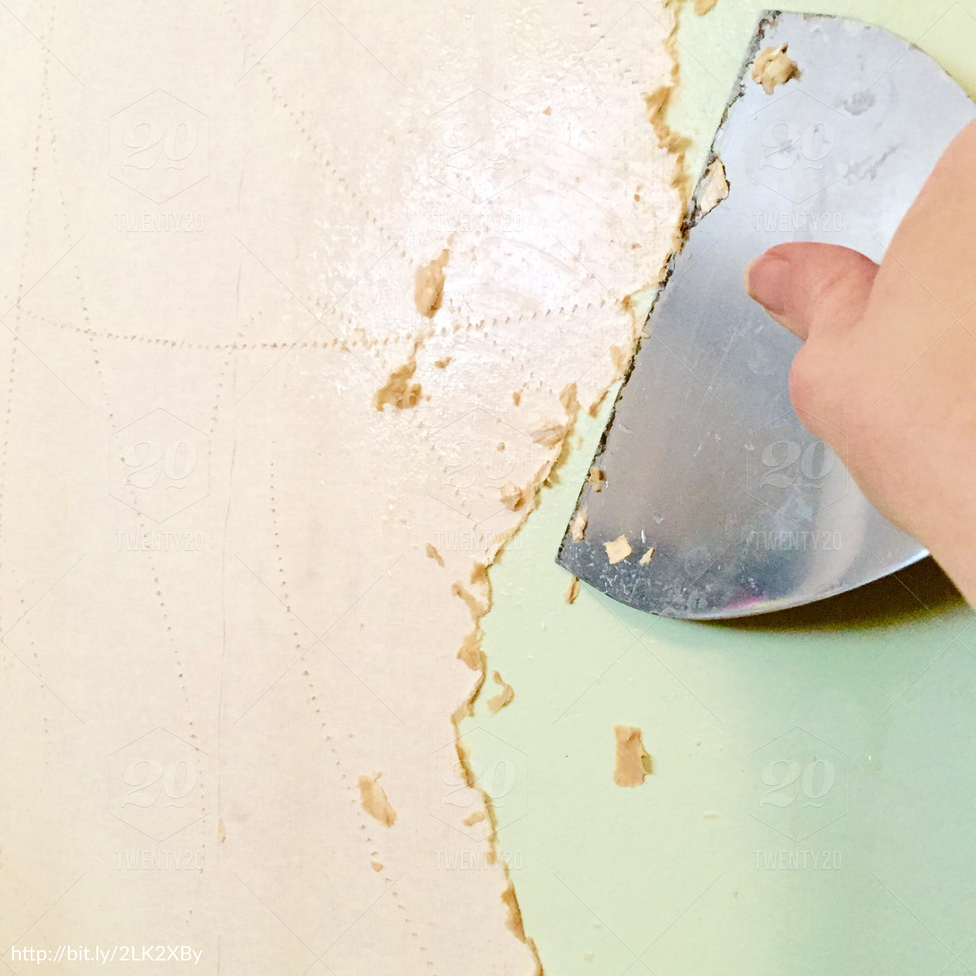
Removing a Container
docker rm does NOT delete the container image .
The container image is from Docker Hub.
It is stored locally in our local repo.
It deletes tehe container instance
The instance will container an overlay
Any changes to the original image are the overlay.
This is why we need OverlayFS in Docker.
Notes:
Instructor Notes:
Please Refer to the Participant Notes. Participant Notes:
We differentiate between the container image and the container instance. The image is not going to be directly deleted this way, but the instance will be.
Knowing the difference between instance and image is extremely important.

Slide 53
Lab 2: Deleting
Navigate to 02-containers/2-deleting.md
Notes:
Instructor Notes:
Participant Notes:

Slide 54
Docker Operations
Notes:
Instructor Notes:
Please Refer to the Participant Notes. Participant Notes:

Slide 55
Networking
Notes:
Instructor Notes:
Please Refer to the Participant Notes. Participant Notes:

Slide 56

Port Mapping
Host can forward network to container
This is done by port mapping.
Notes:
Instructor Notes:
Please Refer to the Participant Notes. Participant Notes:

Slide 57
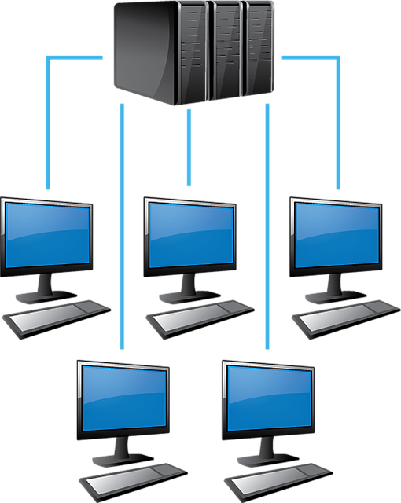
Running a Web Server
We can use nginx, a web server
Why not httpd (apache)?
nginx is really tiny
perfect for a container
The nginx is a container name on Docker Hub
Notes:
Instructor Notes:
Please Refer to the Participant Notes. Participant Notes:

Slide 58
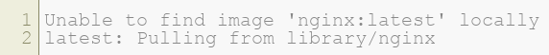
Mapping nginx
nginx needs access to port 80
But we don't want to map port 80 of host
Let's use 8002
Here is the response:
Notes:
Instructor Notes:
Please Refer to the Participant Notes. Participant Notes:

Slide 59

Running in Background
So far, our containers always get stopped when done.
How Do we run it as a background (daemon) process?
Notes:
Instructor Notes:
Please Refer to the Participant Notes. Participant Notes:

Slide 60
Lab 3: Networking
03-networking/3.1-ports
Complete Lab
Notes:
Instructor Notes:
Participant Notes:

Slide 61
Logging

Slide 62
Container Logging
Docker logs commmand:
See the log interactively (tail -f)
Note that this will give us the output of PID 1
Notes:
Instructor Notes:
Please Refer to the Participant Notes. Participant Notes:

Slide 63

Application Logs
Our applications will likely have its own logs
log4j / apache / etc.
We can map a volume to the host using -v
This will map ~/web-logs in the host to /var/log/nginx in the container.
Notes:
Instructor Notes:
Please Refer to the Participant Notes. Participant Notes:

Slide 64
Security

Slide 65

Is Docker Secure?
Running container more secure than running on host.
Namespaces isolate running apps from each other.
CGroups isolate resources by container
Helps avoid one app exhausting all resources
Containers have a very light "attack surface"
Few running processes
Limited libraries
Less things to attack
Notes:
Instructor Notes:
Please Refer to the Participant Notes. Participant Notes:

Slide 66

Docker Security
Docker daemon runs as root
Adding users to Docker group give them access to root.
Don't give access to users that don't have scudo access.
Notes:
Instructor Notes:
Please Refer to the Participant Notes. Participant Notes:

Slide 67
Kernel Exploits
Docker containers share the host Kernel
Kernel exploits in the container can affect host
Compromised code can be run on the host.
Kernel panics will affect all containers.
Notes:
Instructor Notes:
Please Refer to the Participant Notes. Participant Notes:

Slide 68

Resource Starvation
Cgroups can limit access to resources
If not limited, the app can use it up.
Notes:
Instructor Notes:
Please Refer to the Participant Notes. Participant Notes:

Slide 69
Docker Swarm

Slide 70
Intro To Docker Swarm

Slide 71
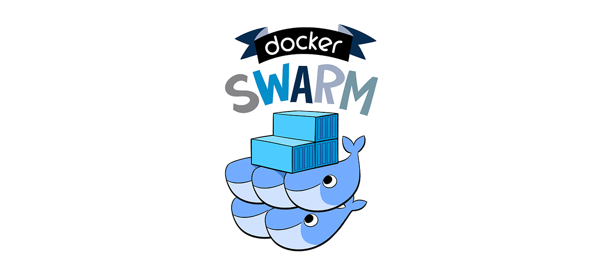
What is Docker Swarm?
Container Orchestration Framework
Similar to Kubernetes and Mesos
Notes:
Instructor Notes:
Please Refer to the Participant Notes. Participant Notes:

Slide 72

Why Docker Swarm?
Easy to Configure
Easy to Deploy
Good for Most Use Cases.
We all already use Docker!
Notes:
Instructor Notes:
Please Refer to the Participant Notes. Participant Notes:

Slide 73
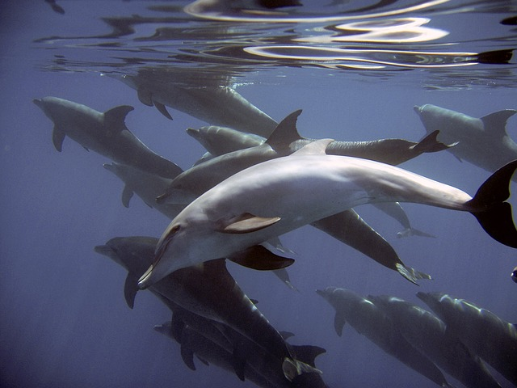
Why Not Docker Swarm?
Not good for large clusters
Not good for complex applications
Notes:
Instructor Notes:
Please Refer to the Participant Notes. Participant Notes:

Slide 74
Comparison
 | Docker Swarm | Kubernetes | Mesos
Release | 07/2016 | 06/2014 | 12/2011
Maturity | Fairly Immature | Mature | Very Mature
Configuration | Very Easy | Complex | Complex
Configuration Type | Configs | Yaml | JSON
Minimum Size (Test) | 1 | 2 | 2
Minimum Size (Prod) | 4 | 4 | 6
High Availability | Yes | Yes | Yes
Rack Awareness | Yes | Yes | Yes
Summary | Easy Configuration excellent for small deployments | Hierarchical "pods" allow for advanced configuration, excellent for complex applications. | Robust, mature platform designed for thousands of nodes.
Notes:
Instructor Notes:
Please Refer to the Participant Notes. Participant Notes:

Slide 75
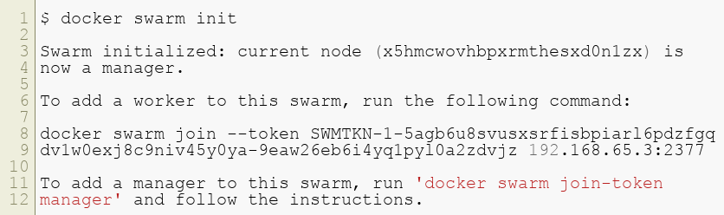
Using Docker Swarm
Starting a new swarm is easy!
Simply run the following:
Notes:
Instructor Notes:
Please Refer to the Participant Notes. Participant Notes:

Slide 76
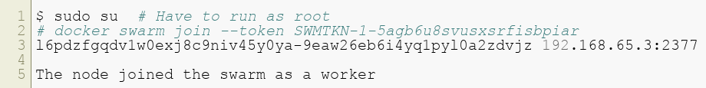

Connecting to the Swarm
We need to connect another machine
Notes:
Instructor Notes:
Please Refer to the Participant Notes. Participant Notes:

Slide 77
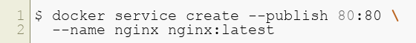

Running a Service
Notes:
Instructor Notes:
Please Refer to the Participant Notes. Participant Notes:

Slide 78
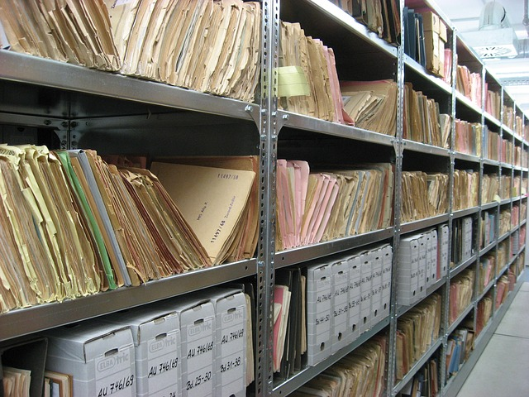
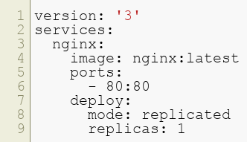
Stack Files
Defines our Swarm
Same format as docker compose (Yaml)
Sample nginx:
Notes:
Instructor Notes:
Please Refer to the Participant Notes. Participant Notes:

Slide 79
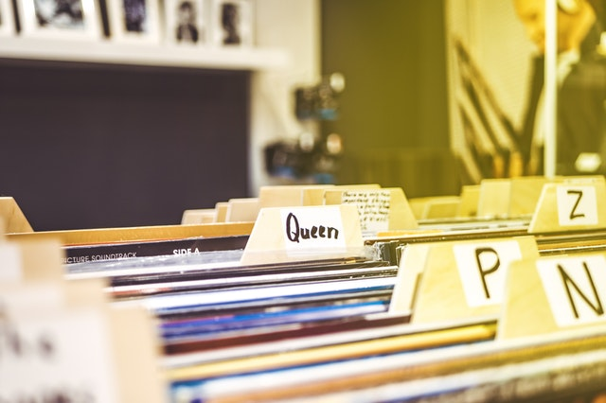
Deploying the Stack File
We can now deploy our stack file
A network will be created automatically
Notes:
Instructor Notes:
Please Refer to the Participant Notes. Participant Notes:

Slide 80
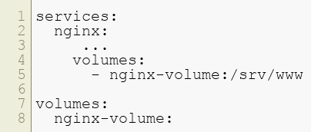
Adding a volume
Containers are immutable
We need to add volumes to persist
Example YAML File for Volume
Notes:
Instructor Notes:
Please Refer to the Participant Notes. Participant Notes:

Slide 81
Docker CLI Tools

Slide 82
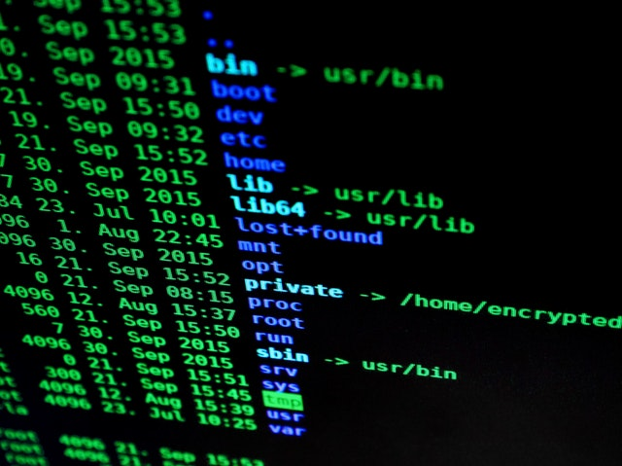
CLI
Most work in Docker is done on the CLI
We have already seen this.
We use the docker command to execute most things
Notes:
Instructor Notes:
Please Refer to the Participant Notes. Participant Notes:

Slide 83

Permissions
Docker service runs as root
Normal users needs to "scudo"
Very annoying for development.
Can add user to docker group:
BEWARE! Gives user root access!
Notes:
Instructor Notes:
Please Refer to the Participant Notes. Participant Notes:

Slide 84
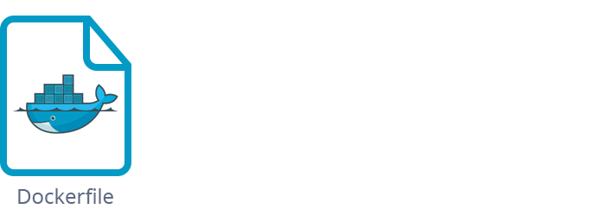
What is a Dockerfile?
Remember that containers are layered .
The base image usually comes from Docker Hub.
Our image has changes to that.
These changes are specified in a Dockerfile.
Notes:
Instructor Notes:
Please Refer to the Participant Notes. Participant Notes:

Slide 85
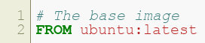
FROM Statement
Dockerfiles always come from somewhere .
We don't start from scratch
Usually some Linux, like alpine.
Here, we will use Ubuntu:
Notes:
Instructor Notes:
Please Refer to the Participant Notes. Participant Notes:

Slide 86

Changes to image
We normally make changes to the image
Example commands:
RUN: executes a command on image
COPY: copies a file to the image.
CMD: executes our app
HEALTHCHECK: Gives us a health check.
Notes:
Instructor Notes:
Please Refer to the Participant Notes. Participant Notes:

Slide 87


Networking
Typically, we expose networking
Here, we expose 5000
Notes:
Instructor Notes:
Please Refer to the Participant Notes. Participant Notes:

Slide 88
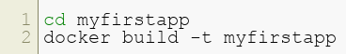
Building
We use the docker build command to build.
We have to have a Dockerfile in the root of the directory
Exaple:
Watch the output -- it will be long!
Notes:
Instructor Notes:
Please Refer to the Participant Notes. Participant Notes:

Slide 89
Lab 4: Dockerfile
Navigate docker-labs/04-Dockerfile/README.md
Notes:
Instructor Notes:
Participant Notes:

Slide 90
Health Checks

Slide 91
Container Health
How do we know if a container is healthy?
Docker doesn't interfere with container.
"Agnostic Design"
Notes:
Instructor Notes:
Please Refer to the Participant Notes. Participant Notes:

Slide 92

Health Checks
Health Checks should be specified in the Dockerfile.
Notes:
Instructor Notes:
Please Refer to the Participant Notes. Participant Notes:

Slide 93
Health Check Example
Following is a line in a DockerFile
This is a health check.
We will use "curl" to check a webservice.
Note that the health check returns 1 (bad) if failed.
Notes:
Instructor Notes:
Please Refer to the Participant Notes. Participant Notes:

Slide 94

Health Checks and Docker Swarm
Docker Swarm requires positive health checks
That means your app should have at least one!
Good practice to have several
Notes:
Instructor Notes:
Please Refer to the Participant Notes. Participant Notes:

Slide 95

Conclusions
Containers are a very powerful tool.
Docker gives us excellent tools for building containers.
Docker Swarm is a lightweight cluster orchestration framework.
Notes:
Instructor Notes:
Please Refer to the Participant Notes. Participant Notes:

Slide 96
Discussion: TBD
Placeholder for first discussion question
Overview:
Time: TBD Minutes
In this exercise, you will: TBD.
Instructions:
This is a full class discussion.
Questions:
TBD
TBD
Notes:
Instructor Notes:
Purpose:.
Questions:
TBD
Instruction Time Estimate: TBD minutes.
Instructions: This is a full class discussion.
Answer:
Follow-up/Debrief:
Participant Notes:

Slide 97
Discussion: TBD
Placeholder for second discussion question
Overview:
Time: TBD Minutes
In this exercise, you will: TBD.
Instructions:
This is a full class discussion.
Questions:
TBD
TBD
Notes:
Instructor Notes:
Purpose:.
Questions:
TBD
Instruction Time Estimate: TBD minutes.
Instructions: This is a full class discussion.
Answer:
Follow-up/Debrief:
Participant Notes:

